Slide 1

Project Report
Prepared by-
Anjali Sharma
T00720931
University of Arkansas at Little Rock

Slide 2

Table of Content
Executive Summary
Business Analysis
Problem Solving Skills
Technical Skills

Slide 3

Executive Summary
Company Challenges:
Adventure Works, a leading bicycle manufacturer, is facing profitability issues despite its strong market presence. High production volumes are not translating into sustainable margins.
Key Findings:
Retail sales are more profitable than wholesale, but certain high-volume products underperformed due to excessive discounts and low demand.
High-cost components and low-volume products significantly impacted margins.
Operational inefficiencies in production and supply chain management further contributed to the profitability decline.
Strategic Recommendations:
Prioritize high-margin, high-demand products while minimizing discounts on low-performing lines.
Optimize production and supply chain processes to improve efficiency and reduce operational costs.
Phase out unprofitable product lines and shift resources toward innovation and top-performing models.
Leverage advanced analytics and data visualization tools to track profitability trends and assess operational effectiveness.

Slide 4
BUSINESS ANALYSIS
COMPANY OVERVIEW
Global Reach: Multinational bicycle manufacturer serving North America, Europe, and Asia.
Mexico Operations: Acquired Importadores Neptuno for key subcomponent production and touring bicycles.
Strategic Focus: Expanding market share, enhancing accessibility, and reducing production costs.
Data Integration: Consolidates transactional and non-transactional data into the AdventureWorksDW2019 warehouse.
Informed Decisions: Supports sales, marketing, and management with actionable insights.

Slide 5
Data Structure Overview
Relational Schema: Supports efficient operations, analysis, and reporting with clear table relationships through the ERD.
Product Management: The Product table tracks product details, procurement, and inventory with the Make Flag field indicating in-house or vendor production.
Bill of Materials: Organizes hierarchical relationships between finished goods and subcomponents, crucial for manufacturing bicycles and assemblies.
Work Order Tracking: Manages manufacturing schedules, production quantities, quality checks, and reasons for failures to ensure inventory alignment.
Primary & Foreign Keys: Maintain table relationships and enable smooth data navigation and reporting.
Process Visibility: Tracks purchase orders, production, and inventory flow from issuance to completion.
Quality Insights: Provides data on inspection failures to address manufacturing inefficiencies and ensure product quality.

Slide 6
ERD and NEXT STEPS
Evaluate Product Performance
Determine the cost structure for each product or service.
Analyze profit margins to ensure pricing strategies are aligned with business goals.
Assess which products or services contribute most to revenue and profit
Understand Customer Profiles
Identify and segment the different types of customers.
Suggest targeted marketing strategies or product enhancements to better serve customer needs.
Determine their needs, preferences, and purchasing behaviors.

Slide 7
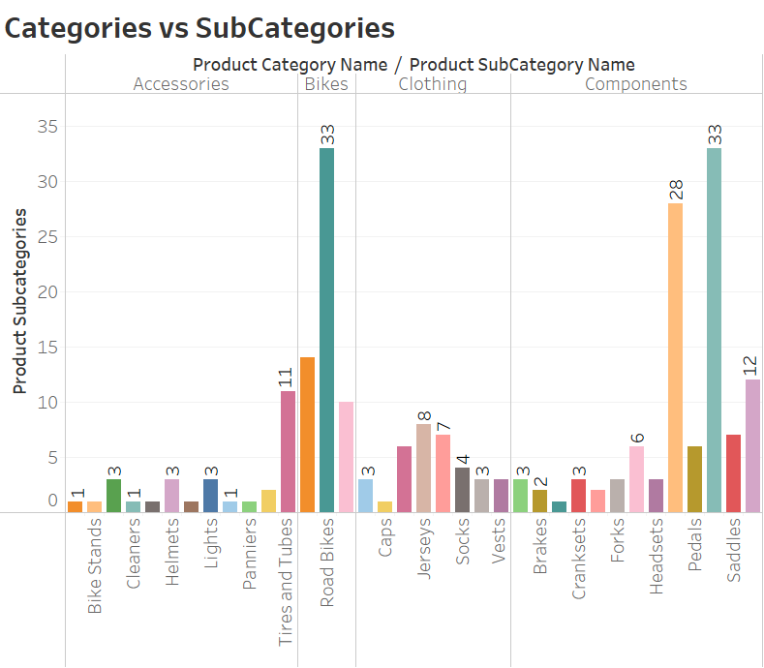
PRODUCTS
Adventure Works Cycles organizes products into models, categories, and subcategories.
504 products are distributed across 295 models, 37 subcategories, and 4 main categories.
Every subcategory is associated with a corresponding product category.
The hierarchical structure enables efficient product management and analysis.

Slide 8
PRODUCT GROUPINGS ANALYSIS
Product Details:
Total Products: The company offers 504 products across various categories and subcategories.
Product Models: 295 product models serve as classifications for similar types of products.
Categorization:
Categories: Products are divided into 4 major categories (e.g., Accessories, Bikes, Components, and Clothing)
Subcategories: These Categories are further broken into 37 subcategories (e.g., Road Bikes, Caps, Helmets, etc.)
Relationship Between Groupings:
Each Product Category encompasses multiple Subcategories, creating a broad classification of products.
Each Subcategory includes a range of Products, and many of these products are further grouped under specific Product Models to organize similar types together.
For example, the category "Clothing" includes subcategories such as "Jerseys" and "Caps." Within the subcategory "Jerseys," a specific product model like "Long-Sleeve Logo Jersey" may group multiple individual products under its name.
Importance of Groupings:
These groupings provide a structured view of the organization’s product offerings, enabling detailed analysis at different levels:
Analyzing by Category (e.g., all "Clothing") allows a high-level overview of sales and inventory trends.
Reviewing by Subcategory (e.g., "Jerseys") helps focus on specific product lines.
Diving deeper into Product Models (e.g., "Long-Sleeve Logo Jersey") provides insight into the performance of specific designs or features.

Slide 9
NEXT STEPS
Customer Segmentation and Behavior
Determine which customers are linked to specific product categories and subcategories.
Recognize whether customers in different categories have unique needs and preferences and align product offerings accordingly.
Revenue Analysis
Examine how each product category and subcategory contributes to overall revenue. Which ones are the top performers?
Determine if certain categories or subcategories experience seasonal sales spikes and adjust strategies to capitalize on these trends.
Profitability and Cost Structure
Assess how profitable each product subcategory is. Are some subcategories generating more profit than others?
Evaluate the cost structure tied to each product subcategory, looking for opportunities to reduce costs while maintaining quality.
Study how customer purchasing patterns vary across product subcategories.
Analyze the distribution of revenue across customer segments and product categories to identify key revenue drivers.
Explore the impact of discounts within specific subcategories and assess if these discounts are justified or need reevaluation based on their impact on profitability.

Slide 10
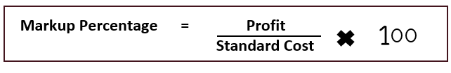
EXPECTED PROFITABILITY
Adventure Works Cycles evaluates profitability by comparing standard costs (production/procurement expenses) with list prices (selling price), revealing potential profit margins.
The company calculates the markup percentage by assessing the difference between list price and standard cost, helping prioritize high-margin products and adjust pricing strategies.
This analysis enables better decision-making to improve profitability, operational efficiency, and market alignment.
Profit = List price – Standard Cost
Most Profitable Product
Mountain-100 Silver
Highest Markup Product
Mountain Bikes Socks
Least Profitable Product
PK-7098 Patch Kit/8
Smallest Markup Product
AWC Logo Cap
Long Sleeve Logo Jersey
Short Sleeve Classic Jersey

Slide 11
NEXT STEPS
Optimizing Inventory
Align inventory levels and supply chain processes with the profitability and demand of each product category.
If Road Bikes are highly profitable, we might increase their stock levels to meet demand and prevent stockouts.
Adjusting Pricing Strategies
Refine pricing and markup strategies based on profitability analysis, especially for less profitable categories.
Increase marketing efforts and promotional activities for high-margin and high-demand products like Road Bikes and Socks.
Conversely, for Caps and Jerseys, which are less profitable, company could reduce inventory levels to avoid overstocking and tie up capital in low-margin items.
For Socks, Adventure works can think about implementing exclusive promotions that showcase their exceptional design and value or introducing time-limited offers to increase sales.
Enhancing Marketing and Sales Efforts
On the other hand, for Caps with the smallest markup percentage, Adventure works might consider increasing the price slightly or bundling Caps with other products to improve overall margins.
Since Socks have the highest markup percentage, we might experiment with pricing strategies to further enhance profitability.
Increase the marketing budget for Road Bikes by investing in targeted advertising campaigns, sponsoring cycling events, and collaborating with cycling influencers.

Slide 12
CUSTOMERS
Adventure Works Cycle serves two primary types of customers: Individuals and Stores.
These customer types are further categorized into three variations: Person Customers, representing individual buyers; Store Customers, representing standalone businesses; and Stores with Contact Customers, which include stores with specific contact with people associated with them.
Customers
Stores
Store Customers
Store with Contact Customers
Individuals
Person Customers

Slide 13
NEXT STEPS
Revenue Optimization
Marketing Campaigns
Tailor marketing strategies based on customer type:
Sales Performance Analysis
Analyze sales performance by customer type to identify high-performing segments:
Prioritize personalized marketing efforts to increase purchase frequency among individuals.
Develop personalized offers for individual customers.
Create bulk purchase incentives for stores (701) and store contacts (635).
Evaluate campaign success rates across segments to refine marketing approaches.
Track individual customer transactions for loyalty insights.
Assess store customer purchase frequency for potential improvements.
Use customer count data to adjust sales tactics and pricing strategies effectively.
Analyze purchasing behavior and preferences to enhance product recommendations.
Focus on individual customers (18,484) as the largest segment for targeted revenue strategies.

Slide 14



SALES OVERVIEW
Key Metrics:
Order Quantity: Represents the number of units of a specific product that has been ordered in a sales transaction. The total sales volume is calculated based on the order quantity for each product in the order.
Cost: Total production or procurement cost, calculated as Order Quantity * Standard Cost.
Revenue: Total earnings from the sale, as indicated by Line Total, which reflects the actual price paid by the customer for the products ordered, accounting for any discounts applied to the unit price.
Line Total = Unit Price * (1 - Unit Price Discount) * Order Quantity
Profit: Difference between Revenue and Cost, representing the earnings after covering the production or procurement cost. It is the key indicator of financial performance per sales.
Markup Percentage: Profit as a percentage of cost, calculated as (Profit / Cost) * 100, which helps evaluate the profitability of a product. A higher markup percentage signifies a higher profit margin for the product.
PROFIT MARGINS
Evaluate Profitability across product lines
Highlight high-markup products
SALES PERFORMANCE
Access sales by products, models, category and subcategory
Identify areas of improvement in sales strategies
REVENUE TRENDS
Analyze Sales growth
Identify top-performing product groupings

Slide 15
SALES ANALYSIS
Product Name | Sum of Profit | Sum of Cost | Sum of Revenue | Sum of Markup Percentage
Mountain-100
Mountain-100 Silver, 38 | 1487.8356 | 1912.1544 | 3399.99 | 77.8093
Mountain-100 Silver, 42 | 1487.8356 | 1912.1544 | 3399.99 | 77.8093
Mountain-100 Silver, 44 | 1487.8356 | 1912.1544 | 3399.99 | 77.8093
Mountain-100 Silver, 48 | 1487.8356 | 1912.1544 | 3399.99 | 77.8093
Grand Total | 5951.3424 | 7648.6176 | 13599.96 | 311.2372
Profitability based on | Product | Product Model | Product Sub-Category | Product Category
Most Profitable | Mountain-200 Black, 42 | Mountain- 200 | Mountain Bikes | Bikes
Least Profitable | Road-650 Red, 44 | Road-650 | Road Frames | Clothing
Most revenue | Mountain-200 Black, 38 | Mountain- 200 | Road Bikes | Bikes
Least Revenue | LL Road Seat/ Saddle | LL Road Seat/Saddle 1 | Chains | Accessories
Highest Markup % | Fender-Set Mountain | Fender Set - Mountain | Fenders | Accessories
Lowest Markup % | Long-Sleeve Logo Jersey, L | Long-Sleeve Logo Jersey | Jerseys | Components

Slide 16
SALES ANALYSIS

Slide 17
NEXT STEPS
Conduct a Stakeholder Analysis
Identify Key Products: Focus on the most and least profitable products like Mountain-200 (most profitable) and Road-650 (least profitable).
Define Key Performance Indicators (KPIs)
Select Product-Specific Metrics: Use metrics like profit margin for the Mountain-200 and return rates for the Road-650.
Perform a Root Cause Analysis
Analyze Performance: Investigate why the Mountain-200 is highly profitable and why Road-650 is underperforming.
Gather Insights: Collect feedback from stakeholders about these specific products to understand their performance.
Communicate Findings: Keep stakeholders informed about insights related to the profitability of these products
Set Targets: Define performance goals for both the most and least profitable products.
Review Performance Regularly: Monitor KPIs to track the profitability of these products over time.
Investigate Customer Feedback: Review of feedback to identify specific issues impacting the least profitable products.
Develop Action Plans: Create strategies to enhance the performance of underperforming products like the Road-650.

Slide 18
RETAIL VS WHOLESALE
Key Metrics:
Retail Sales: Adventure Works sells directly to individual consumers, typically through online channels, offering products for personal use without the need for a salesperson.
Wholesale Sales: Business customers, such as stores, place bulk orders with customized pricing and may require personalized interactions with sales representatives.
Strategic Differentiation: The distinction between retail and wholesale sales enables Adventure Works to tailor pricing, marketing, and customer service strategies to meet the unique needs of each customer group.

Slide 19
CATEGORYWISE RETAIL VS WHOLESALE ANALYSIS

Slide 20
NEXT STEPS
Loss Attribution Analysis
Dive deeper into the data to pinpoint the specific factors contributing to the 217% loss in wholesale sales.
Analyze profit margins, pricing strategies, and inventory costs associated with wholesale to inform corrective actions.
Investigate historical sales data to identify any patterns or events correlating with spikes in wholesale losses.
Volume Contribution Assessment
Scenario Planning
Analyze market share by volume for both retail and wholesale segments to understand competitive positioning and opportunities for growth.
Dive deeper into individual product performance. Assess which products have the highest sales volumes in each channel and analyze their profitability to inform strategic decisions on inventory and marketing focus.
Model potential revenue outcomes by adjusting retail and wholesale sales volumes to predict impacts on overall profitability.
Analyze fixed and variable costs associated with scaling up retail or wholesale operations to evaluate the feasibility of each scenario.
Develop various scenarios based on potential changes to retail and wholesale strategies. For example:
Scenario A: Increase wholesale marketing efforts to sustain and further capitalize on existing sales volume while optimizing retail activities.
Scenario B: Enhance operational efficiencies in wholesale distribution to reduce loss percentages while continuing to strengthen retail sales strategies.

Slide 21
LOSS ANALYSIS
Wholesale Segment Losses: Losses are more concentrated in the wholesale segment, despite high sales volumes, indicating that excessive discounts and customized pricing could be eroding profitability.
Discount Impact: Wholesale sales often involve bulk purchases with larger or deeper discounts, which may be reducing profit margins and contributing to financial losses.
Regional and Sales Factors: Sales performance varies by region, with certain territories or sales teams potentially missing upselling opportunities or offering unprofitable discounts, impacting overall profitability.

Slide 22
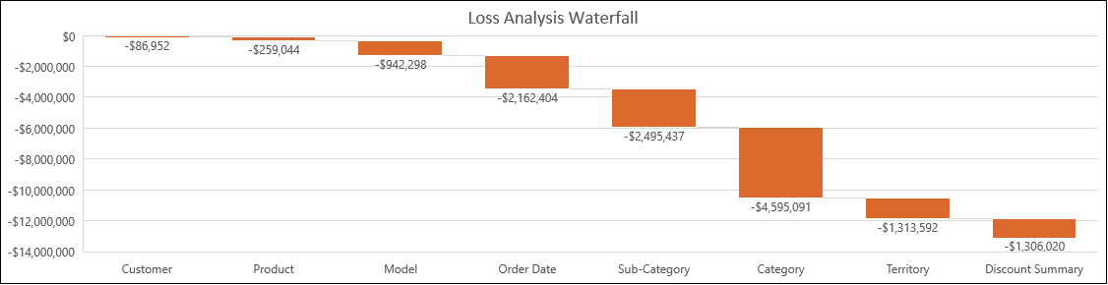
CATEGORYWISE LOSS ANALYSIS

Slide 23
NEXT STEPS
Re-evaluate pricing and discount strategies
Given the substantial losses tied to certain discount categories (e.g., Price Reduced: 46.4% / (No Discount) 0.0%), review and optimize pricing models to balance competitive pricing with profitability.
Review of Sales and Marketing efforts
Collaborate with the marketing and sales teams to identify better ways to promote products in high-loss subcategories and explore product bundling or marketing campaigns that could mitigate losses.
Implement Targeted action plan for key areas
Implement actionable plans to adjust or eliminate unprofitable discount strategies, particularly those linked to high losses (e.g., Price Reduced: 46.4% / (No Discount) 0.0%).
Certain discount strategies are driving significant losses, such as discounts greater than 40%. Test lower discount thresholds to see if profitability improves while maintaining competitiveness.
Test different pricing models to identify the most effective strategies that maximize revenue without compromising margins.
Develop specific marketing campaigns targeting high-loss products or subcategories, such as Road Bikes and Bikes. These campaigns can emphasize product value, or introduce new customer incentives (e.g., loyalty programs) to increase sales without compromising profit margins.
Ensure sales teams are trained on profitable pricing strategies and discount levels, focusing on upselling and cross-selling to reduce reliance on heavy discounts and minimize losses.
Improve sales forecasting models to ensure that product inventory is aligned with expected demand, reducing unnecessary markdowns and sales losses.

Slide 24
RECOMMENDATIONS
1. Focus on Profitable Products, Models, Subcategories, and Categories:
Prioritize High-Profit Products: Focus on top-performing products, models, and categories with the highest profit margins, such as Mountain-200 or Mountain Bikes, by targeting marketing and sales efforts.
Optimize High-Profit Models: Promote high-margin models and consider bundling with accessories to increase overall transaction profitability.
Promote Profitable Categories: Increase visibility of profitable categories like Mountain Bikes through strategic promotions, positioning them as premium offerings with minimal discounts.
2. Reevaluate and Optimize Discount Strategies:
Reduce Aggressive Discounts: Limit large price cuts in loss-heavy categories like Bikes and Road Bikes, focusing on volume-based or tiered discounts to protect margins.
Bundle Discounts: Offer bundle deals, like bike accessories with bikes, to increase transaction value and profitability for low-margin products.
Targeted Offers: Create special offers for specific customer segments, such as first-time buyers or loyal customers, ensuring alignment with profitability goals.
Monitor Discount Strategies: Continuously assess discount strategies' impact on sales and profitability, adjusting based on data and market trends.
3. Regional Recommendations:
Address High-Loss Territories: Reevaluate pricing and promotions in the Southwest US, analyzing local preferences and competitor strategies to improve profitability.
Localized Promotions: Create region-specific campaigns for popular models like Road Bikes and Mountain Bikes, aligning with local customer preferences.
Expand Focus on Profitable Regions: Invest in regions with high profitability, directing marketing and sales efforts to further capitalize on these areas.

Slide 25
PROS and CONS of RECOMMENDATIONS
1. Focus on High-Profit Products, Models, Subcategories, and Categories:
Pros:
Increases revenue by prioritizing successful product lines.
Reduces reliance on underperforming products, improving overall efficiency.
Promotes a stronger market position for premium offerings.
Cons:
May reduce variety in promotions, impacting customer satisfaction.
Risk of saturating the market for high-margin products.
2. Reevaluate Discount Strategies:
Pros:
Protects margins by avoiding excessive price reductions.
Encourages higher sales volumes through tiered discounts and bundling.
Aligns pricing strategies with profitability goals.
Cons:
Reduced discounts may alienate cost-sensitive customers.
Bundling and tiered discount strategies require careful planning and monitoring.
3. Regional Recommendations:
Pros:
Addresses region-specific challenges, reducing localized losses.
Expand opportunities in profitable territories.
Increases market share in underperforming areas.
Cons:
Requires significant investment in regional market analysis.
Tailored strategies may complicate overall operations.

Slide 26
PROBLEM SOLVING SKILLS
Clearly define the problem scope and desired outcomes
Define Problem
Gather relevant data, clean, organize, and validate data to ensure accuracy
Data Collection and preparation
Applied Statistical methods, visualizations, and cross validate calculations to uncover trends and patterns
Analyze the data
Create actionable insights based on analysis and give recommendations for alignment with organizational goals
Develop Recommendations

Slide 27
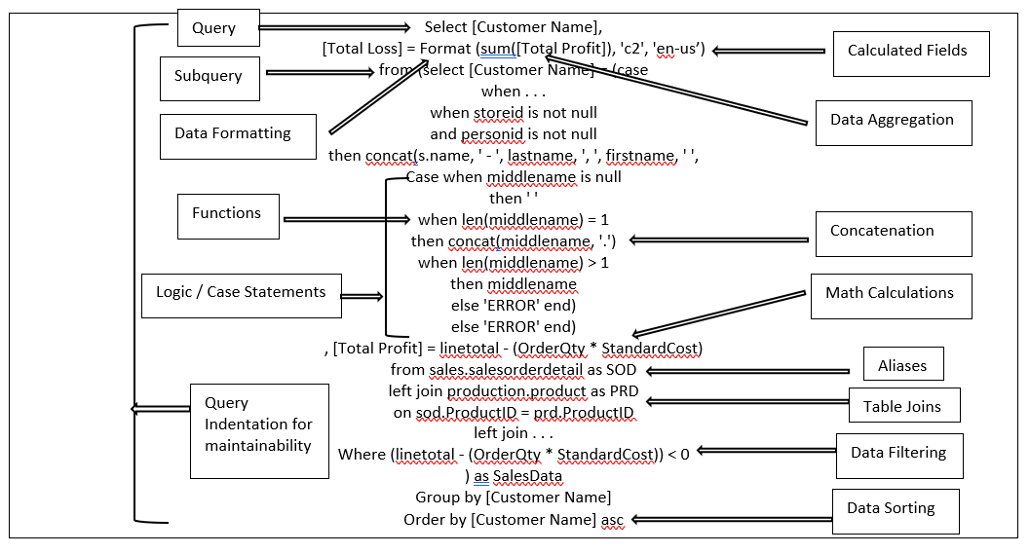
TECHNICAL SKILLS
STRUCTURED QUERY LANGUAGE

Slide 28
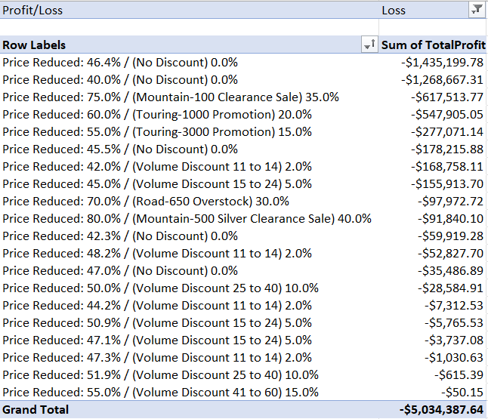
TECHNICAL SKILLS
Excel Charts
Excel Pivot Tables

Slide 29
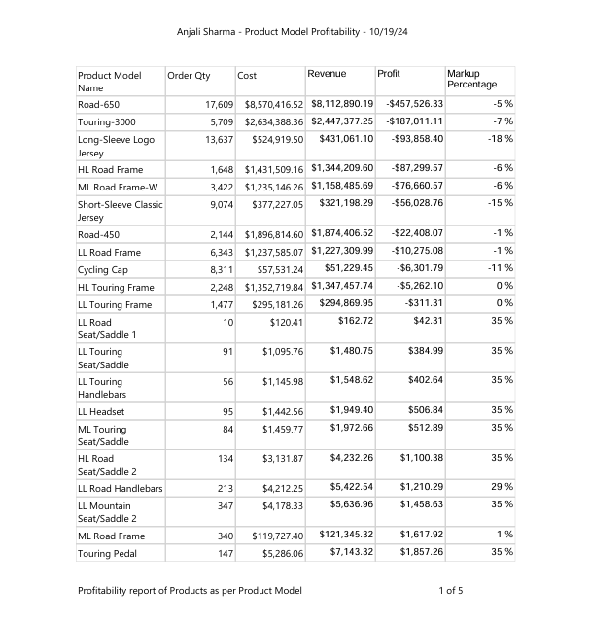
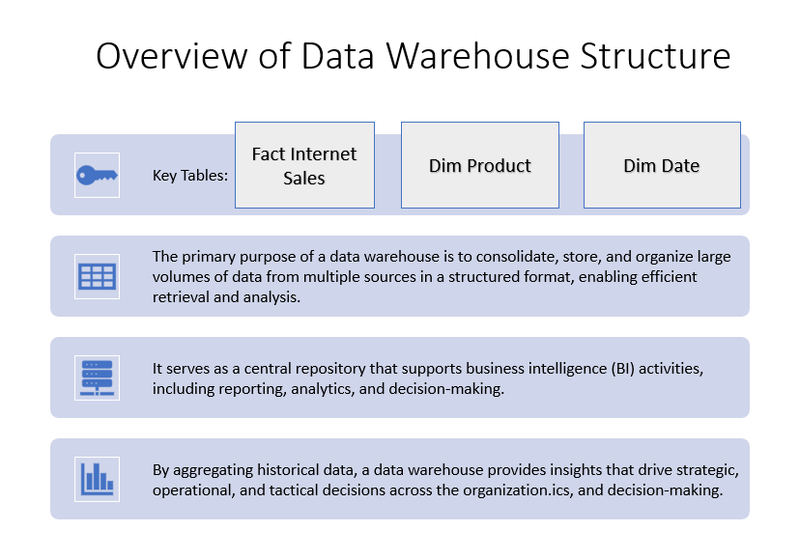
TECHNICAL SKILLS
SQL Servers Reporting Services reports
PowerPoint Presentations

Slide 30
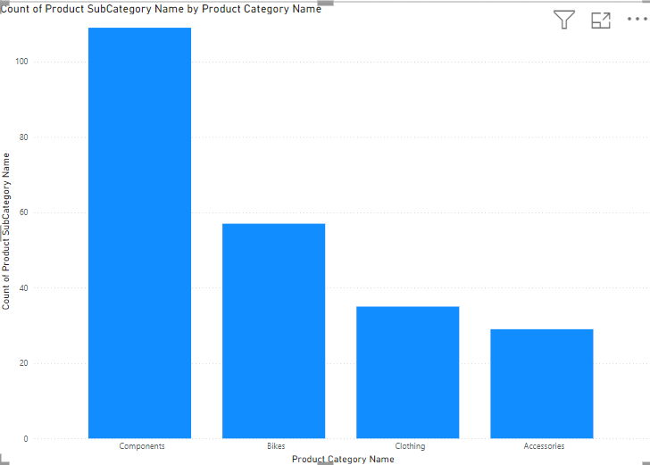
TECHNICAL SKILLS
Power BI Dashboard
Tableau Dashboard

Slide 31


